Slide 1



Jupyter Notebooks
Joseph Ramia
Data Scientist, Delaware North Analytics

Slide 2
Reproducible Data Science
An increasingly important aspect of doing data science in enterprises is creating results in support of decision-making that are reliable, valid, and reproducible.
Collaboration and effective communication are critical to accomplishing these objectives.
One tool that has been developed to facilitate both is the Jupyter Notebook.

Slide 3
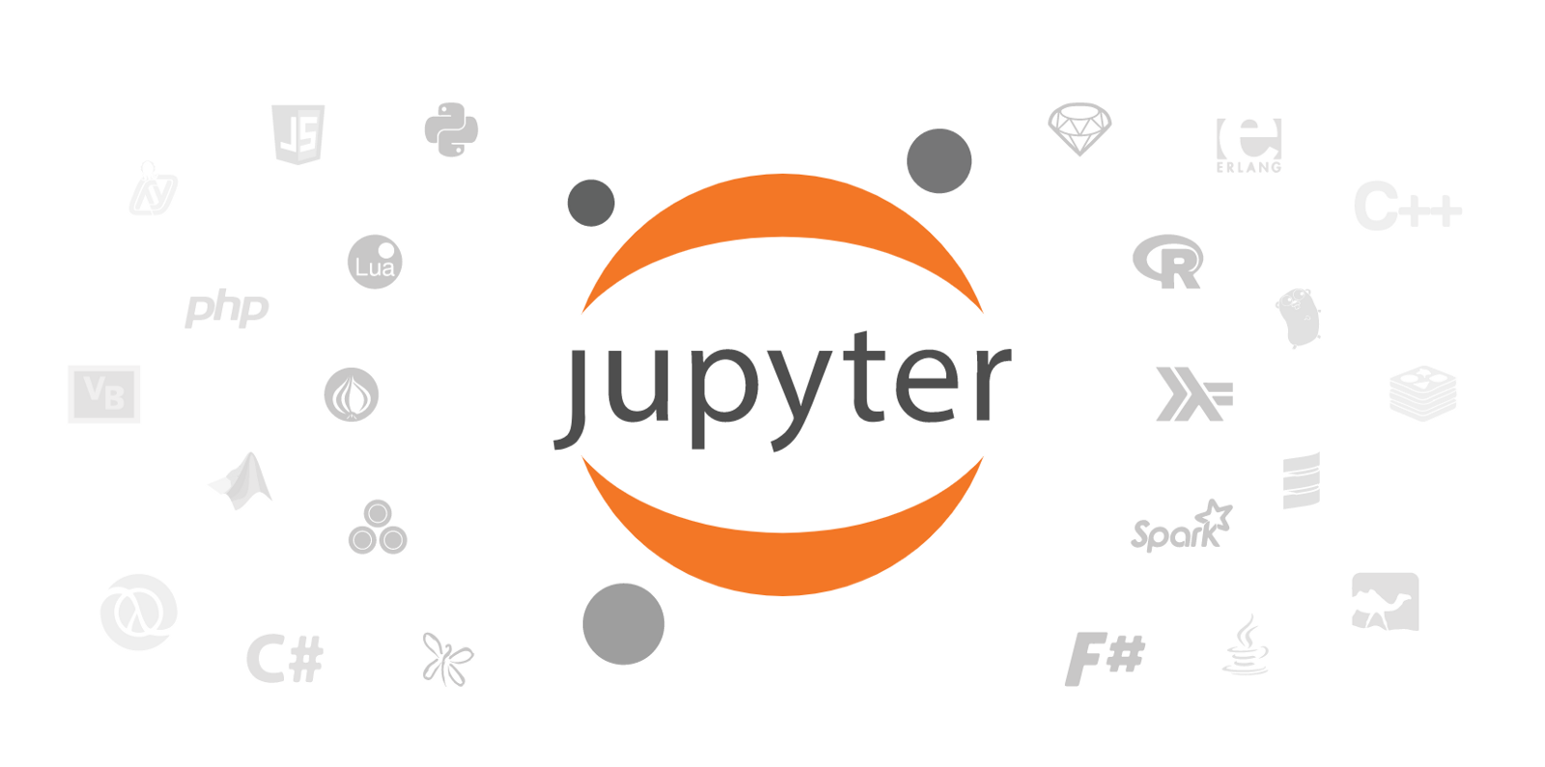
Notes:
The Jupyter Notebook is an authoring, analysis, and reporting application developed specifically for the purposes of facilitating agile and reproducible science using Python and other languages, like R and Julia.
Jupyter Notebooks make it easier for you to do not just coding, but a style of coding that facilitates reproducible data science, literate programming .

Slide 4

Literate Programming
Proposed by Don Knuth in 2014
"Let us change our traditional attitude to the construction of programs: Instead of imagining that our main task is to instruct a computer what to do, let us concentrate rather on explaining to humans what we want the computer to do.“
Notes:
The value and reproducibility of data science efforts can be greatly improved if data science work products are "self-explanatory," allowing users and stakeholders to understand what they are for, what they do, and what they produce.

Slide 5

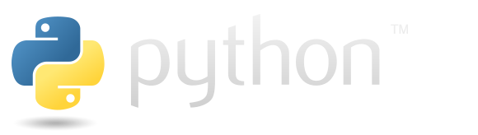
Installation
Good for beginners
Pre-loaded with the most popular libraries and tools
Large installation
To get Jupyter:
Download the latest version of Anaconda for Python 3 (ignore Python 2.7)
Install Anaconda by following the instructions on the download page and/or in the executable
Jupyter will come pre-loaded and can be found in the start menu
More advanced users
Manage your libraries and tools manually
Lightweight installation
To get Jupyter:
Download the latest version of Python (ignore Python 2.7)
Enter “pip install jupyter” into the Command Prompt
Once the installation has finished, enter “jupyter notebook” into the Command Prompt to launch Jupyter

Slide 6
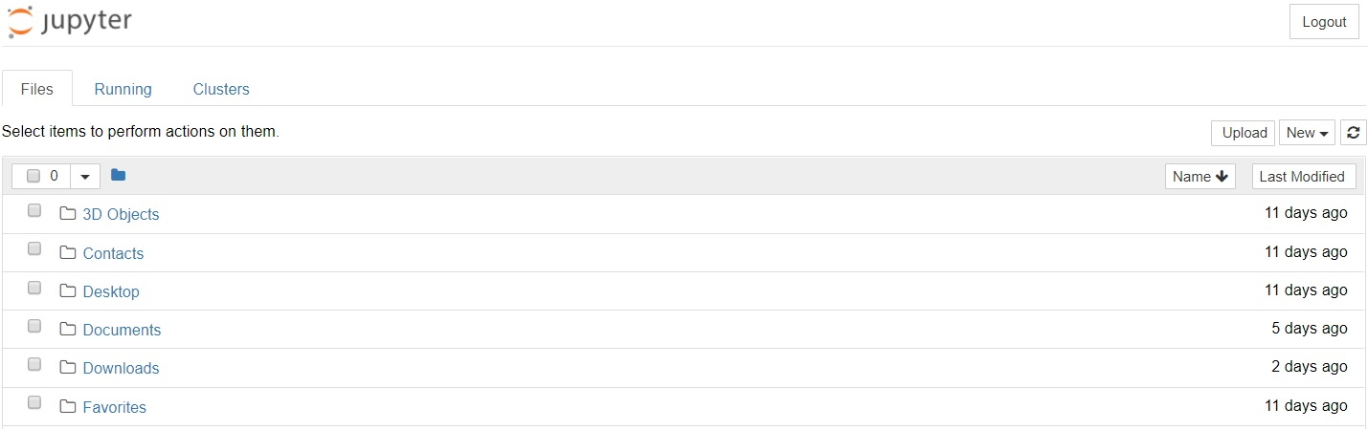
Launching Jupyter
Launching Jupyter will open a new tab in your default web browser that should look something like the following:
Notes:
This is the Notebook Dashboard, specifically designed for managing your Jupyter Notebooks.
Think of it as the launchpad for exploring, editing and creating your notebooks.
The dashboard will give you access to the files and folders in your current directory. You can navigate to the directory you’d like to work in, or change the directory beforehand (https://stackoverflow.com/questions/35254852/how-to-change-the-jupyter-start-up-folder)
The URL for the dashboard is something like http://localhost:8888/tree. Localhost is not a website, but indicates that the content is being served from your local machine: your own computer. Jupyter’s Notebooks and dashboard are web apps, and Jupyter starts up a local Python server to serve these apps to your web browser, making it essentially platform independent and opening the door to easier sharing on the web.

Slide 7
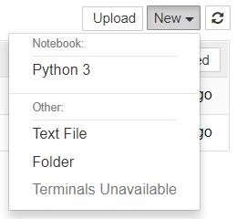
Creating Your First Notebook
Browse to the folder in which you would like to create your first notebook
Click the “New” drop-down button in the top-right and select “Python 3” (or the version of your choice)
Your first Jupyter Notebook will open in new tab (each notebook uses its own tab because you can open multiple notebooks simultaneously)

Slide 8

Thank you!

